Slide 1
Advertisement campaign
Medha Jha

Slide 2

Product
The company has come up with a new product for the Indian market – a body spray.
For women.
Different from deodorants and perfumes.
Handy, long lasting, quality fragrance.

Slide 3

About the CLIENT
Aromatics Private Limited is a leading company in the Indian market, selling various fragrance products for women – soaps, body creams, shower gel etc. It is an established fragrance brand with 40% market share, continued high sales and customers’ loyalty over the years of its existence.

Slide 4
Market Background
The Indian market is dominated by deodorants (antiperspirants and scented) and other fragrance products like perfumes, body gels, body creams etc.
Aromatics, hence, came up with a body mist which is of premium standards, but in economy pricing.

Slide 5
Marketing Objectives
Introduce the product in the market.
Increase sales.
Gain market share.
Attract users of the premium products by emphasizing the equally good quality, easy availability and reasonable pricing of the product.

Slide 6
Competition
The other body mists available in the market of the premium category – The Body Shop, Bath and Body Works etc.
Deodorants (antiperspirants and scented)
Perfumes
Other fragrance products like body gels, body creams etc.

Slide 7
Advertisement objectives
To communicate the launch of a new fragrance product that is pretty handy, long lasting and can be easily re-applied.

Slide 8
Media strategy
Print (Magazines and Glossy Newspapers)
Television commercial
Online
Outdoor (hoardings and transits)

Slide 9
Target Audience
Demographic – City women, working class, college going, teenagers.
Psychological – women who are particular about self-grooming, fragrance and body reactions by beauty products.
Behavior – aware of beauty products, interested in buying quality products, conscious of health hazards.

Slide 10
Unique selling proposition
Long lasting high quality fragrance

Slide 11
Tone of voice
Informative, fun, warm.

Slide 12
Creative strategy
To communicate the longevity and quality of fragrance in day to day lives of modern independent women.

Slide 13
Central theme – the big idea
Defining a young, confident, independent, well-groomed woman as having a personality that stands out. This is related to her having a signature scent to herself by which people can recognize her immediately.
Creative copy/tagline – “Your Signature Scent”

Slide 14
Execution
By portraying a slice of life of women with different personalities with the body mist on which gives them that extra hint of attention and makes people’s heads turn as they pass by.

Slide 15
Media strategy
A combination of traditional, non traditional and other classes of media is to be used keeping the target audience in mind, i.e., women.

Slide 16
Media Objective
Create awareness in 60% of target audience with a reach of 80%.

Slide 17
Implementation - media vehicles
Traditional :
Newspapers – Glossy newspapers mostly the lifestyle/sunday issues of leading newspapers.
Magazines – Femina, Elle, Filmfare, Women’s Era, Cosmopolitan
TV Commercial

Slide 18
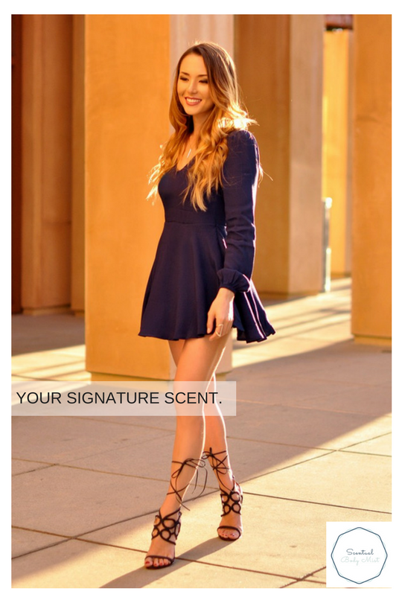


Slide 19
Implementation - media vehicles
Non-traditional :
Online shopping websites – Flipkart, Jabong, Myntra, Purplle, Nyyka
Facebook and Instagram – Depending on the users searches/likes, ad can be placed in their newsfeed of these two social platforms
Youtube – Commercial made for the TV to be played on Youtube as well – skip-able and placed on videos relating to women’s grooming and beauty

Slide 20
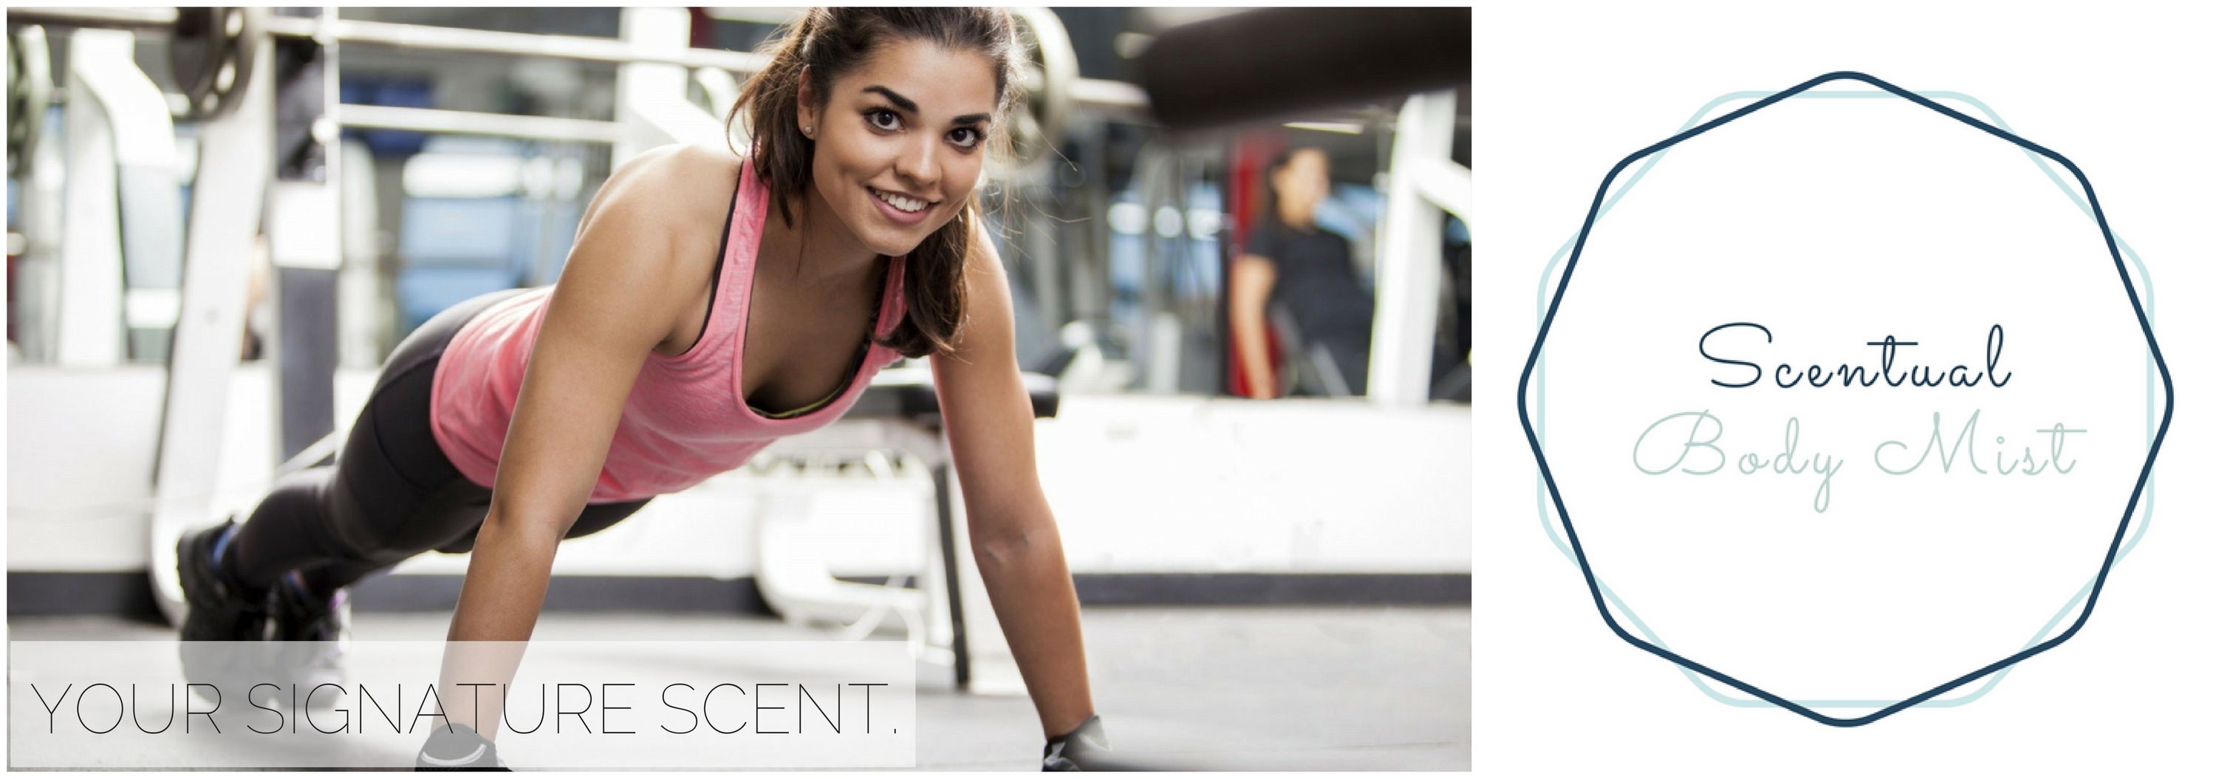

Slide 21
Implementation - media vehicles
Others :
Billboards – in 1st tier cities near supermarkets and shopping malls
Direct Mailers – people subscribed to online beauty websites/blogs can be directly mailed with the information about the product

Slide 22
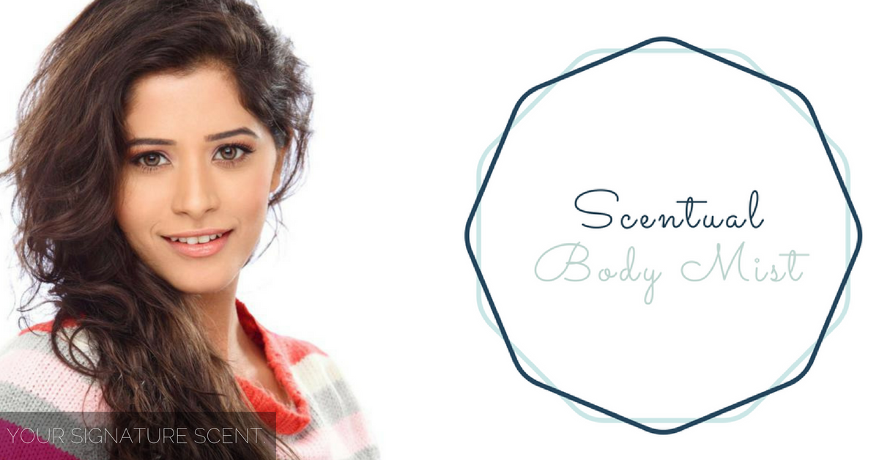

Slide 23
THANK YOU ☺
QUESTIONS?

